Slide 1

SpaceX Launch Success Prediction
IBM Data Science Capstone Project
Presented on: 30th June 2023
Presented by: Saif UR Rehman

Slide 2

Project Overview
Data collected from Wikipedia and Data repository of SpaceX
Explored data with SQL and Python
Folium was used for visualization and presentation of data in shape of graphs and maps
Various Machine Learning Models were used to prepare a data model for decision making purposes

Slide 3

Introduction to SpaceX Launch System
As per data from the SpaceX a routine launch of Falcon9 rocket costs 62 million dollars, a competitor on the other hand costs the same endeavor more than 165 million dollars.
SpaceX can reap the cost advantage based on its state-of-the-art rockets and launch and land system for its various stage rockets.
Using data science and machine learning we can predict that what are the probabilities of a launch to be successful by successfully landing its various stages.
This project will try to predict the same using data already available and feeding it to the MLM already developed

Slide 4

Project Objectives
To find out the successful landing factors
To determine how various launch parameters impact the rate of landing success
To get the set of conditions necessary to ensure a successful landing

Slide 5

Methodology
Following Steps will be completed in this section using various tools already learnt in the process
Data Collection
Data Wrangling
Exploratory Data Analysis
Visualization
Predictive Analysis

Slide 6

Data Collection
Data was collected using various methods and techniques to extract launch records, parse the table and convert into dataframe for future analysis these steps are as described in bullets below
GET Request from SpaceX API
.Jason() function was used to decode responses
.Jason_normalize() to convert data into pandas dataframe
Removed missing values and outliers using data cleaning
Web Scraping with BeautifulSoup method was used to collect data from Wikipedia

Slide 7
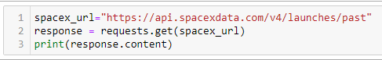
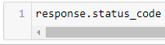
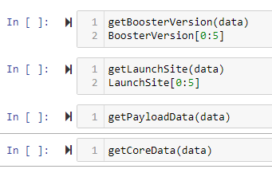
Method1: Data Collection using API
Requesting data from SpaceX web link and printing the file contents to verify contents are loaded
Getting data from URL
static_json_url='https://cf-courses-data.s3.us.cloud-object-storage.appdomain.cloud/IBM-DS0321EN-SkillsNetwork/datasets/API_call_spacex_api.json'
check if the above GET request was successful using status_code, remember 200 shows a successful response
using .json() to decode the response and convert into a data frame for other mathematical operations possible
From many data fields only keeping those necessary for our project
data = data[['rocket', 'payloads', 'launchpad', 'cores', 'flight_number', 'date_utc']]
Getting the data ready for usage
Create a pandas data from the data dictionary
data=pd.DataFrame.from_dict(launch_dict,orient='index').transpose()

Slide 8
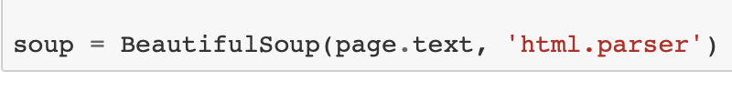
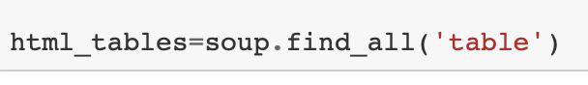
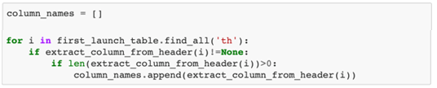
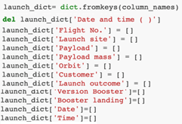
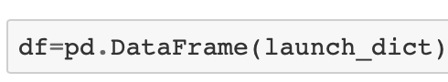
Method2: Data Collection using Web Scraping
Requesting HTML Page and Assigning to an Object
Create BeautifulSoup and fill the table
Extract Column Names
Convert to pandas data sets and dictionaries

Slide 9

Method3: Data Wrangling
Exploratory Data Analysis (EDA) helped in determining the training labels.
Launch Statistics and Orbit Occurrences were calculated for each site
Outcome of landing of each launch was exported to a csv file for further processing

Slide 10


Method4: Data Visualization
As shown in the left side a line-graph and a bar chart was prepared using various tools
The graphs show the relationship between payload, launch site, type of orbit and flight number of each Falcon9 rocket.
A trend can be seen which represents a sharp rise in success rate from year 2013 to 2020.

Slide 11



Method5: Using Folium for interactive mapping
Folium was used to mark all launch sites as interactive objects on a map
Markers like launch sites, distances, success/failure rates were added.
Predictions of future launches were also plotted using 0 and 1 on the map, further distances from various proximities were marked
Thus high probability sites for successful launch were highlighted on map

Slide 12
Method6: Building a Dashboard with Plotly Dash
Plotly dash was used to build an interactive dashboard
Various Graphs and Charts were drawn to show launch, orbit and landing features.

Slide 13

Method6: Predictive Analysis
Using numpy and pandas the data we obtained from previous activities were split into training and testing classifications
Machine learning models were built using GridSearchCV
Accuracy metrix was used for modeling
Selection was made on best performing model

Slide 14
Significant Insights from Exploratory Data Analysis
Following insights were drawn from the data available for the Project
Success rate depends on the number of flights launched from any site: The site with greatest launches was the most successful
Success rate depends on the payload mass, the greater the mass of a rocket payload the greater chances it has for success
Type of Orbit has direct relationship with rate of success, certain orbits hold greater successes
As discussed in previous slides, the most recent years have seen a greater success rate from 2013 onwards

Slide 15
Some useful information obtained from data using SQL
S/No. | Instance | Readings
1 | Total Launch Sites | 4
2 | Total Payload carried by NASA’s Rockets | 45,596 KG
3 | Falcon flies with average Mass | 29,284 KG
4 | First Successful Flight was on | 22 December, 2015
5 | Success Ratio | 89%

Slide 16
Discussion on Results

Slide 17
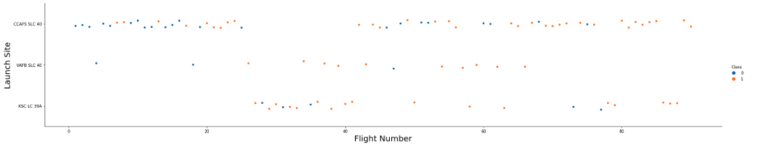
Flight Numbers plotted against Launch Sites
Over the period of time, launch sites has been shifted
Most flight successes were obtained from one particular site, i.e KSC LC 39A
Most unsuccessful flights were made from CCAFS SLC 40

Slide 18
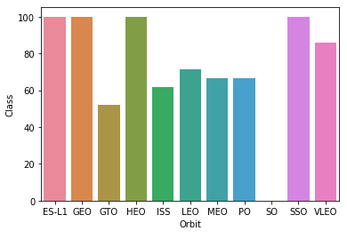
Orbital Success Rate
Flights flew to different orbits with variable success rates
No success was observed at SO Orbit.
Total Success was observed for four orbits, i.e., ES-L1; GEO; HEO; SSO

Slide 19
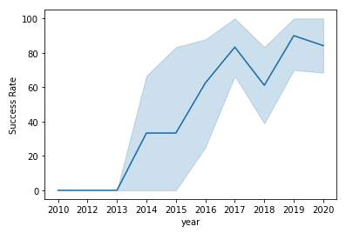
Yearly Recorded Success Trends
No success observed from 2010 to 2013
Success started from 2013 and went on to reach maximum in 2019.
Slight dips in trend were observed in 2015, 2018 and 2020.

Slide 20



Using Folium for Interactive Mapping
Launch Sites as shown in terrain maps of USA.

Slide 21
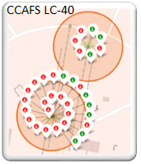
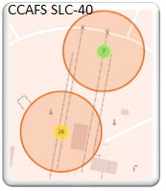
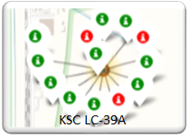
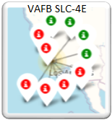
Launch Sites with Success/Failure Statistics

Slide 22
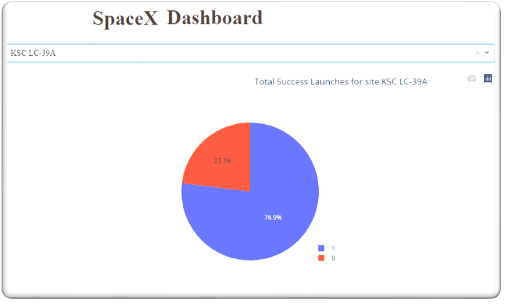
Highest Launching Success Ratio
Interactive Dashboard with PLOTLY DASH
Launch site KSC LC-39 also has the highest ratio success ratio with a ratio of 76.9%.

Slide 23

PLOTLY Dash was used for creating Dashboard
An interactive dashboard with PI Charts and Bar Charts was created using plotly dash.

Slide 24
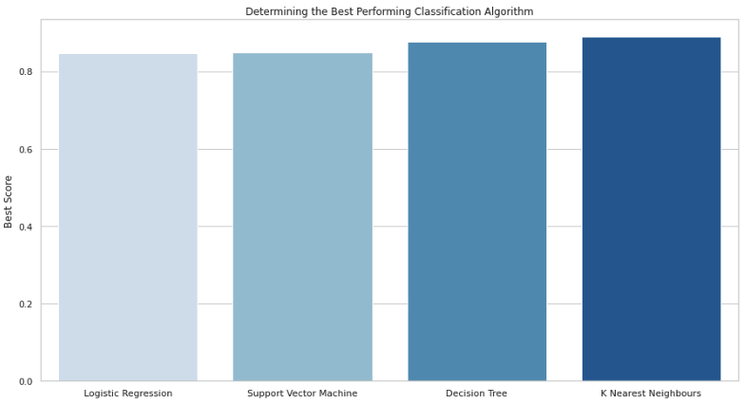
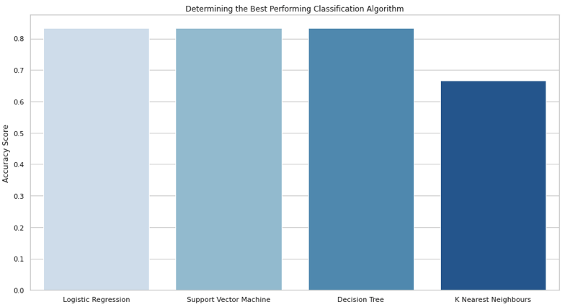
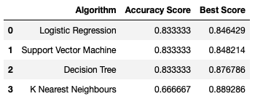
Predictive Analysis Model Selection

Slide 25
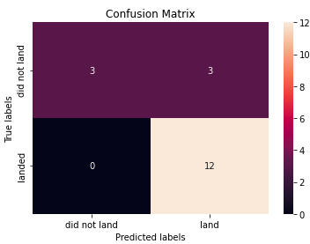
Predictive Analysis
Being the best analysis model available, the Predictive Analysis was completed using decision tree and the confusion matrix thus obtained provided following predictions
Successful Launches predicted = 12
Unsuccessful Launches predicted = 3
False positive launches successful = 3

Slide 26
Conclusion (Unique Insights from the Project)
As the number of flights increased, the rate of success at a launch site increased.
Most of the early flights were unsuccessful.
Between 2010 and 2013, all landings were unsuccessful
After 2013, the success rate generally increased, despite small dips in 2018 and 2020.
Orbit types ES-L1, GEO, HEO, and SSO, have the highest success rate of 100%.
Launch site KSC LC-39 A had the most successful launches, with 41.7% of the total successful launches, and also the highest rate of successful launches, with a 76.9% success rate.

Slide 27
Thank You
Following is the link to my git hub resource set.\
https://github.com/rehmansaif/Saif.git

